Slide 1
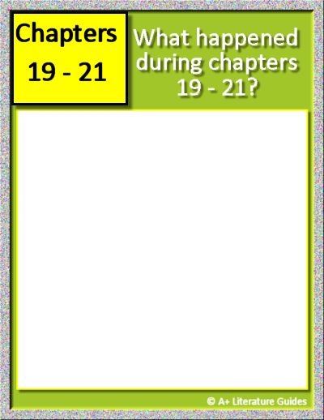
Chapter 19
Insert text
Insert text
Insert text
Insert text
Insert text
Chapter 20
Insert text
Insert text
Insert text
Insert text
Insert text
Chapter 21
Insert text
Insert text
Insert text
Insert text
Insert text
Click and type here.
For each chapter, record:
Chapter’s setting
Main events
One of the following:
Character actions, relationships, traits
Internal/external conflicts/challenges, solutions/resolutions
Themes, messages
Questions, predictions
Mood, tone

Slide 2
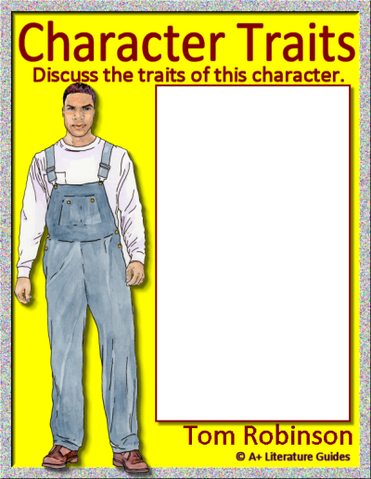
Character Trait Word Bank
Absent-minded
Aggressive
Ambitious
Boastful
Bold
Bossy
Brave
Calm
Careful
Caring
Compassionate
Compliant
Creative
Cruel
Curious
Determined
Distrustful
Dreamy
Empathetic
Energetic
Fair
Focused
Friendly
Hardworking
Helpful
Honest
Humble
Imaginative
Independent
Jealous
Kind
Lazy
Loud
Loyal
Mature
Mean
Mysterious
Nosy
Nurturing
Observant
Overconfident
Patient
Persistent
Polite
Principled
Protective
Pushy
Quiet
Reckless
Reflective
Reserved
Resilient
Responsible
Rude
Selfish
Serious
Shy
Simple
Smart
Sneaky
Stubborn
Thoughtful
Thoughtless
Trustworthy
Understanding
Watchful
Withdrawn
Insert text
Insert text
Insert text
Insert text
Insert text
Insert text
Insert text
Insert text
Insert text
Insert text

Slide 3
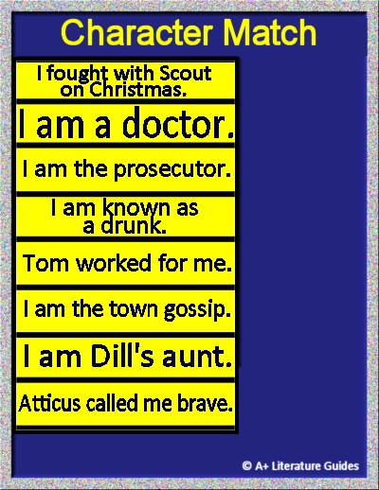









Drag and drop each character to correctly match the statements.

Slide 4

Chapter 22
Insert text
Insert text
Insert text
Insert text
Insert text
Chapter 23
Insert text
Insert text
Insert text
Insert text
Insert text
Chapter 24
Insert text
Insert text
Insert text
Insert text
Insert text
For each chapter, record:
Chapter’s setting
Main events
One of the following:
Character actions, relationships, traits
Internal/external conflicts/challenges, solutions/resolutions
Themes, messages
Questions, predictions
Mood, tone

Slide 5
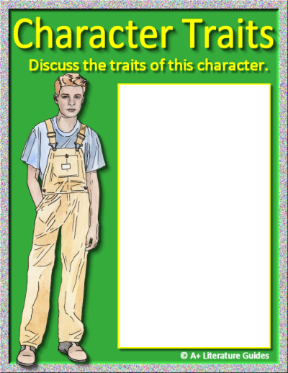
Character Trait Word Bank
Absent-minded
Aggressive
Ambitious
Boastful
Bold
Bossy
Brave
Calm
Careful
Caring
Compassionate
Compliant
Creative
Cruel
Curious
Determined
Distrustful
Dreamy
Empathetic
Energetic
Fair
Focused
Friendly
Hardworking
Helpful
Honest
Humble
Imaginative
Independent
Jealous
Kind
Lazy
Loud
Loyal
Mature
Mean
Mysterious
Nosy
Nurturing
Observant
Overconfident
Patient
Persistent
Polite
Principled
Protective
Pushy
Quiet
Reckless
Reflective
Reserved
Resilient
Responsible
Rude
Selfish
Serious
Shy
Simple
Smart
Sneaky
Stubborn
Thoughtful
Thoughtless
Trustworthy
Understanding
Watchful
Withdrawn
Insert text
Insert text
Insert text
Insert text
Insert text
Insert text
Insert text
Insert text
Insert text
Insert text
Jem

Slide 6
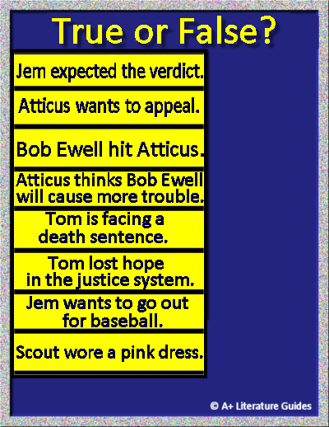


Drag and drop each option to correctly identify which statements are true or false.

